Slide 1

Promoting end of life care in a long stay hospital setting: Cheshire Home,
Shatin, Hong Kong SAR
Dr Elsie Hui, FRCP
Chief of Service, Shatin Cheshire Home
Deputy Hospital Chief Executive, Shatin Hospital
Service Director (Primary & Community Health Care)
New Territories East Cluster

Slide 2
Long Term Care
Hospital
RCHE
Community

Slide 3
Hospital-based Infirmary Services in Hong Kong
Central Infirmary Waiting List (CIWL)
  To provide personal and nursing care to elders or disabled persons who have reached the stage that active and intensive medical treatment cannot reverse their health conditions
Priority Infirmary Application
  Persons who require frequent admissions and significant clinical care in hospital setting
To promote dignified and quality living during the remaining period of their lives.
http://www.ha.org.hk/haho/ho/cs/v3/serviceguide_gis-en.htm

Slide 4
Infirmary Services in Hong Kong
For elders who are medically stable, hospitals may not be the most ideal place for long term care
  Economical: Less costly??
  Patient: Infirmary care outside of hospitals may be more homely with better psychosocial support without compromising the quality of care
  Ageing-in-place policy – Infirmary Care Supplement in Residential Care Homes for the Elderly
A survey conducted by the Hospital Authority in 2002 found that 82% of the applicants on the Central Infirmary Waiting List and 65% of patients in infirmary beds could be cared for in a non-hospital setting – Social Infirmary

Slide 5
Hospital-based infirmary
Patient care outcomes (Quality indicators)
Enhance Quality of Life
  Maximize self-care capacity
  Sustain community orientation
Reduce Risk
  Fall rate
  Incidence rate of pressure ulcer development
  Unintentional weight loss of less than 10% within 6 months
  Nosocomial infections
Effectiveness of Nursing Intervention
  Patient satisfaction
  Reduce Accident & Emergency Department Attendance
Specialty Nursing Service Guideline – Infirmary Nursing. HAHO-COC-GL-NUR-009-v02.

Slide 6
Shatin Cheshire Home
Ward (no. of beds) | Patient Type | Bed stat
W1 | CIWL | 29
W2 | CIWL | 29
W3 | CIWL | 26
W4 | CIWL | 26
W5 | CIWL | 26
W6 | CIWL | 26
Total Bed Number→ |  | 162
* CIWL- Central Infirmary Waiting List

Slide 7
Person-Centred Care in Shatin Cheshire Home
Pressure injury prevention
Spasticity prevention and management
Medication reconciliation & de-prescribing
Nutritional care
End of Life care

Slide 8
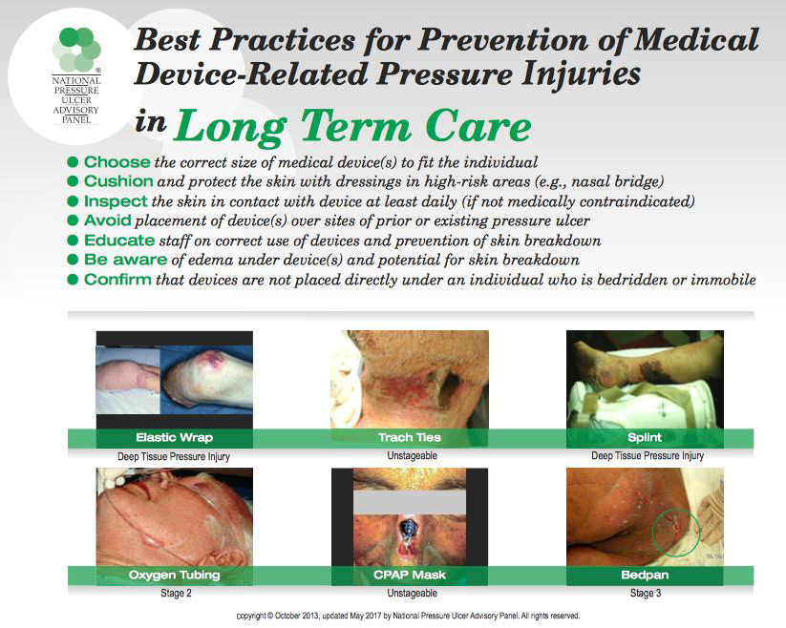

Slide 9
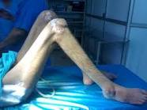
Spasticity Prevention & Management
Spasticity and contractures are major causes of pain, joint deformity, and co-morbidity in infirmary residents
  progressive functional limitation
  impact carer burden and patient’s quality of life
integrated multidisciplinary approach including restorative nursing care, physiotherapy, occupational therapy and drug treatment

Slide 10
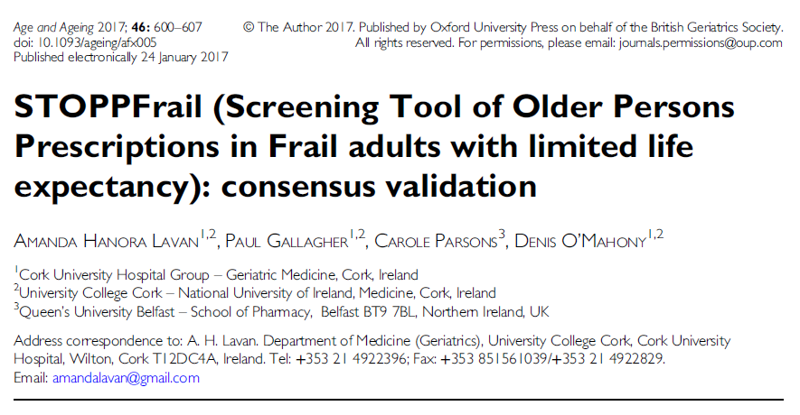
Medication reconciliation and De-prescribing
Lavan AH, O'Mahony D, et al. Age Ageing. 2017 Jul 1;46(4):600-607.

Slide 11
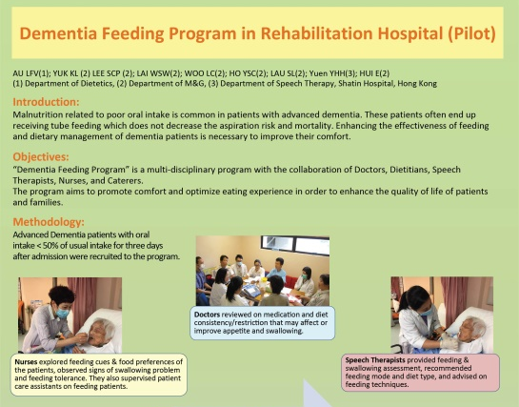
Dementia Feeding Programme

Slide 12
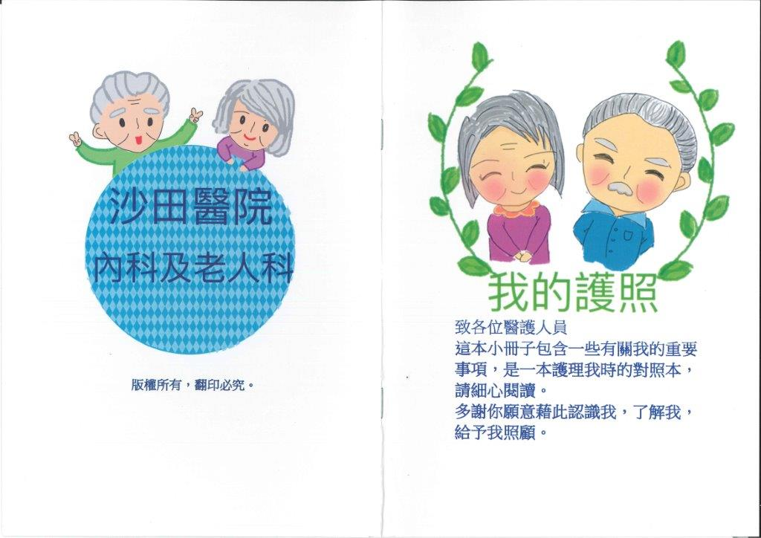
Dementia Passport

Slide 13
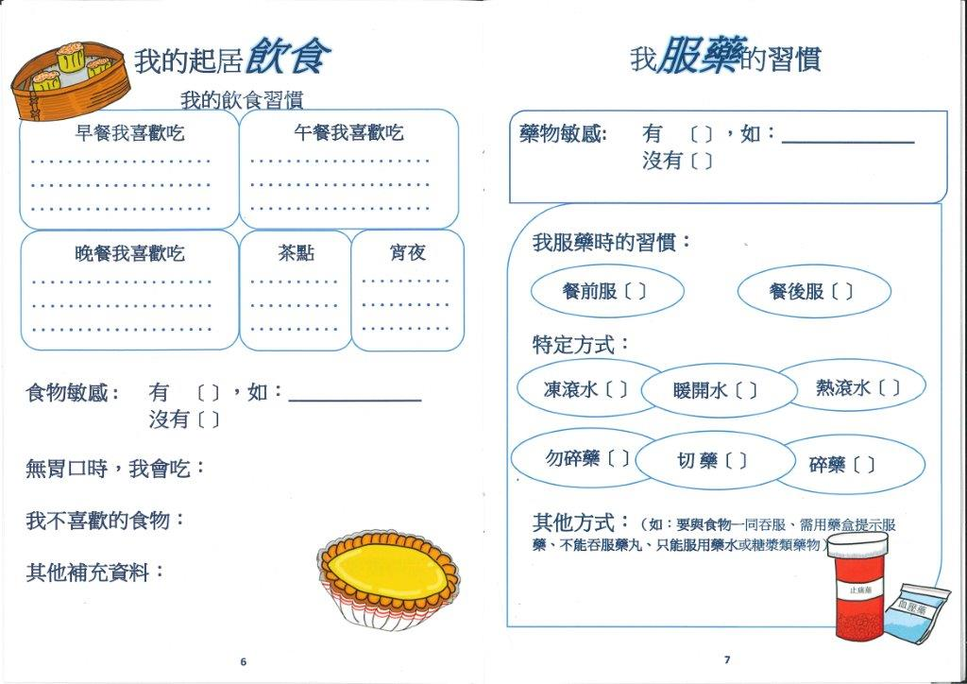
Dementia Passport

Slide 14

End of Life Care
To promote dignified, quality living until the very end

Slide 15
Advance Care Planning (ACP)
Opportunities
  New admissions to SCH had ACPs established in Residential Care Homes
  Many family members eager to start ACP conversation
  SCH nursing staff have good rapport with residents and their families
  A gesture of showing care (PCC)
Challenges
  Some residents do not have next of kin
  Traditionally medical dominance vs nurse-led model
  Some residents are young (mentally retarded) and deemed not approaching EOL

Slide 16
Staff Engagement
  Palliative Care team: Training sessions with Nurse Consultant, Palliative Care nurses, clinicians
  Nursing Faculty, The Chinese University of HK: focus group, workshops
  Staff rotation to designated EOL wards in Shatin Hospital
    Hands-on EOL patient care
    Symptoms identification and control
    ACP conversation
    Dementia Feeding Programme
    Documentation
    Bereavement support
    Sharing and reflections

Slide 17
New Service Model in Shatin Cheshire Home
Integration with SH M&G Department on 1/7/17
New service model fully implemented in Jan 2018
Patient-centered Care
Promotion of Dying and Caring in place
Though Advance Care Planning (ACP)
Provide choices for patients (and relatives),
promote dignity & comfort
till the end of their lives

Slide 18
Clinical Governance
Hospital Governing Board SCH
Dr Herman Lau
Hospital Chief Executive
Dr. Elsie Hui *
Consultant & Chief of Service
Dr. Winnie Ng * Dr Yuk KL *
AC AC Ward 6
Dr. Kingsley Cheung #: Ward 1,4,7,8 & Chalets
Dr. Au KM: Ward 2,5
Dr. Joey Ng: Ward 3
Medical Officer
* Specialist
# Full time on-site doctor
# AC: Associate Consultant

Slide 19





New Service Model - Features
Clear Documentation
Call System Reform
Advance Care Planning (ACP)
PWH/SH/SCH Geriatric Team
Proactive Approach

Slide 20
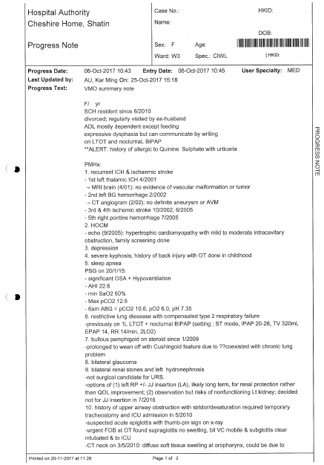
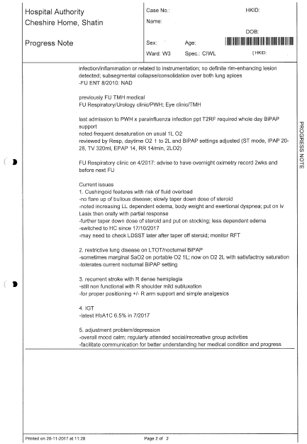
Documentation in Clinical Management System
General background
100%
Past medical history
List of current problems

Slide 21

In-patient Medication Order Entry (IPMOE)
Fully implemented in August 2018 in all SCH wards

Slide 22



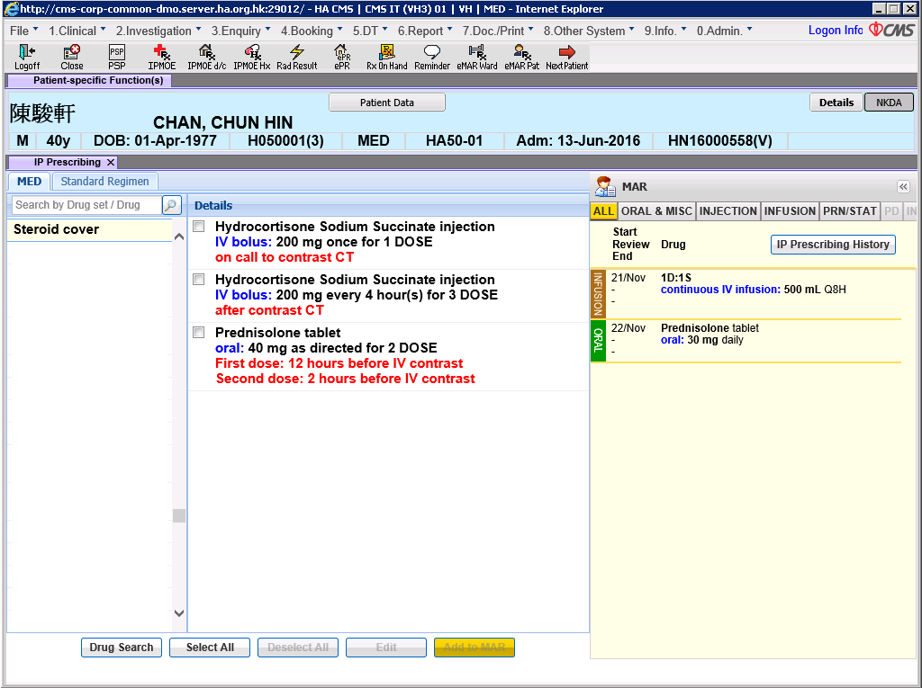



Telemedicine
Real example – IPMOE prescription by SCH off site doctor
SCH in-patient with fever and vomiting
Report progress
Doctor-iPad with 4G Network
Doctor on MTR on the way home
Review Hx in CMS
Prescribe using IPMOE
SCH Ward Nurse
Report progress
SCH off site Doctor
Also asked whether need to send patient to AED for management
Contact ward nurse to double confirm prescriptions and avoid AED attendance
Consulted SCH off-site on call doctor for management and advice
Prescribed antibiotics (allergy Hx by system check), IV fluids and anti-emetic drugs by IPMOE via Doctor-iPad with 4G
During non-office hours, SCH in-patient with fever and vomiting, but other vital signs and general condition remained stable
Reviewed patient Hx (including ACP) and recent lab results in CMS by Doctor-iPad via 4G
SCH Ward Nurse
SCH off site call doctor
7

Slide 23



Way forward - “Seeing is believing”
Proposed further installation of “Skype for business” on iPads
Current limitations
  Need verbal description of patient’s condition, signs and symptoms by ward nurse
  Skin conditions, local or specific physical signs maybe difficult to describe verbally
  Currently at most send photos via HA Chat / HA Email

Slide 24
Promotion of Advance Care Planning (ACP)
Pre-integration:
Total no. of patients: 2
% among CIWL: 1.4%
Post-integration
(Oct, 2018):
Total no. of patients: 58
% among CIWL: 42%

Slide 25
Promote Dying in Place and Reduction in Transfers
Same number of deaths, but 77% (vs 40%) of death case stayed in SCH rather than transfer out to acute hospital.
1.9 fold increase in dying in place
64% reduction in transfer rate per month

Slide 26
Mortality Audit in SCH
Audit Period: | 1 Jan – 30 Jun 16 | 1 Jan – 30 Jun 17 | 1 Jan – 30 Jun 18
Number of cases died in SCH: | 10 (42%) | 8 (40%) | 17 (77%)
Number of cases died after transferred out to other hospital | 14 (58%) | 12 (60%) | 5 (23%)
Total number of death cases (include death after transferred to other hospital): | 24 | 20 | 22
Number of Coroner’s request: | No data | No data | 0
Number of death cases underwent CPR: | No data | No data | 0

Slide 27
Promote Dying in Place and Reduction in Transfers

Slide 28
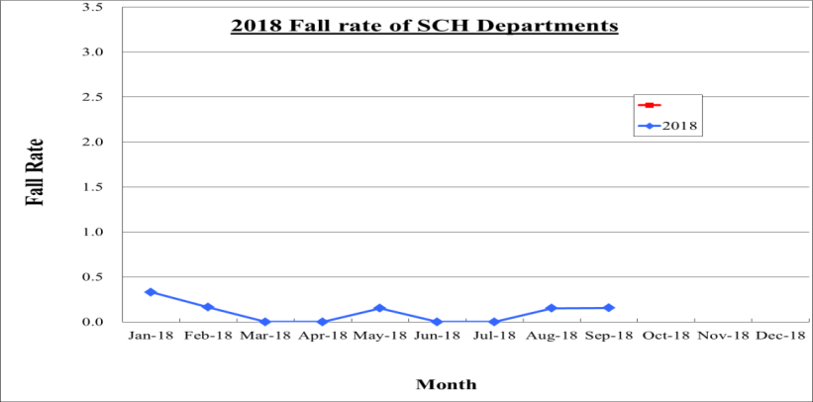
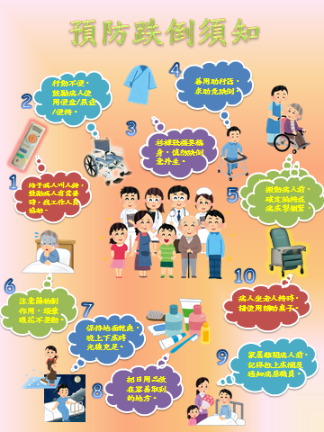
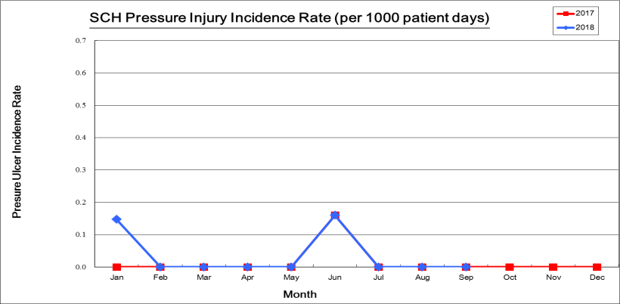
Key Performance Indicators
2017 HA group 3 hospital average 0.33
2017 HA group 3 hospital average 0.06

Slide 29
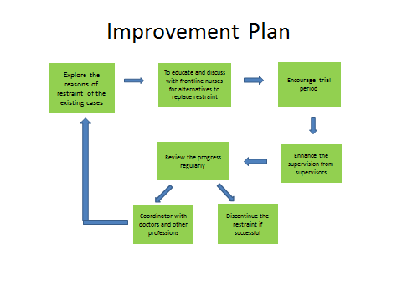

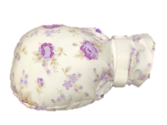
Physical Restraint Reduction Program
Data Collection and Analysis in February 2018
4.95%
Interventions:
To explore alternatives
  Doll therapy, hand mittens, low beds, alarm pads, etc.
Process of trial
  To release patient during meal time, when relatives /maid accompanies
  To try releasing all restraints at daytime
  To try release all restraints whole day
Physical Restraint Rate:
4.95% to 1.4%

Slide 30
Way Forward
Rotation of nursing staffs to SH 6AB for exposure to EOL care
Real-time video-link to on-call doctors
Promotion of ACP to all SCH residents
Elderly-friendly environment

Slide 31
Appreciation from family
Leung WY, F/80
Dementia, Ischaemic Stroke, Hypertension
Ms Leung was on tube feeding, ADL totally dependent with on and off dyspnoea with sputum retention.
DNACPR order signed July 2015 and established December 2017.
Developed desaturation and sputum retention on 5 August 2018. Put on intravenous antibiotic and Buscopan infusion for symptomatic control. Relative agreed to cotninue comfort care in SCH and opted not to transfer to acute hospital.
End-of-life room was provided and relatives were encouraged to stay with patient. Ms. Leung passed away on 18 August 2018. Appreciation card and flowers were received from relatives.

Slide 32




Slide 33


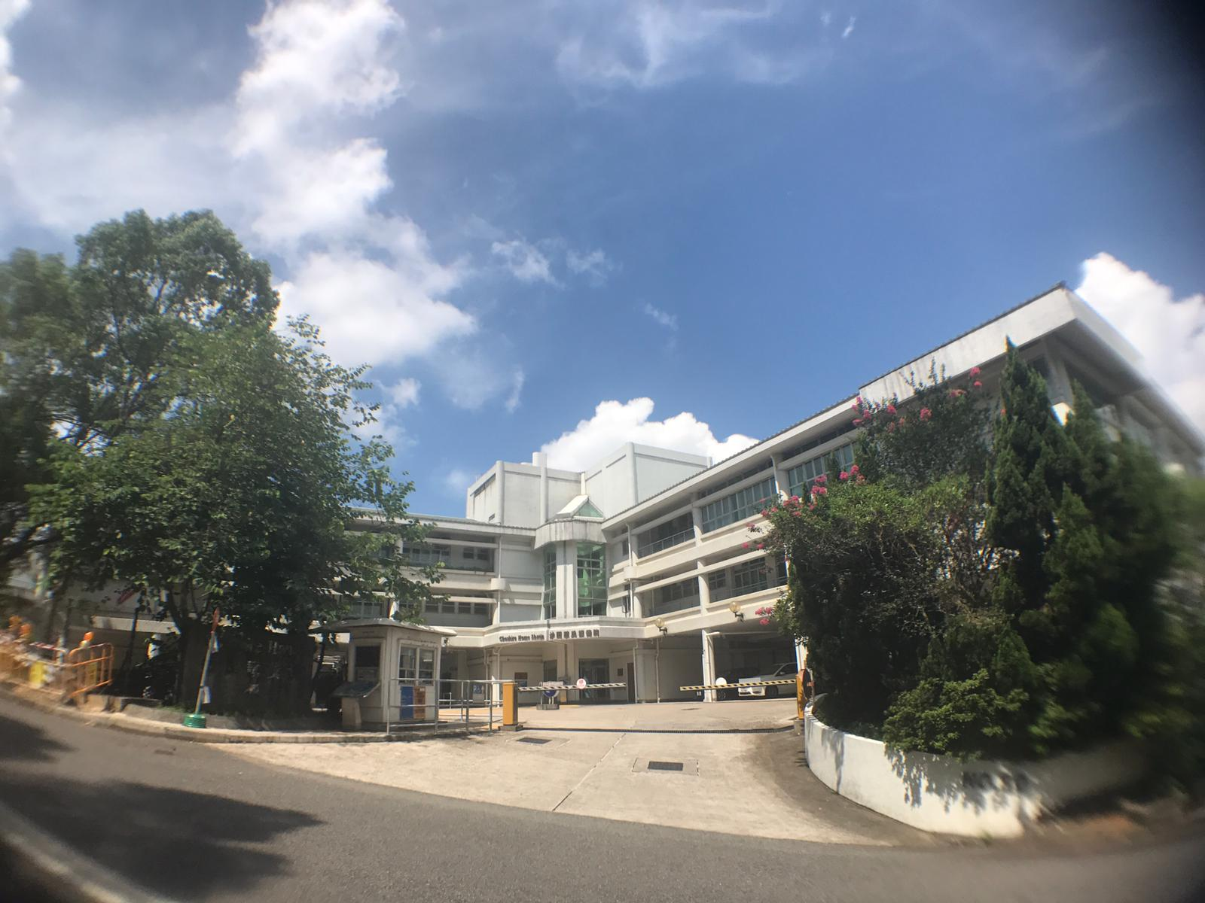
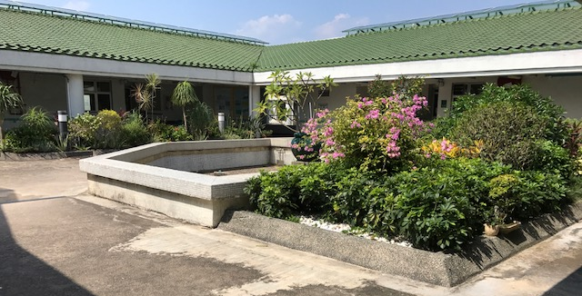
Thank you
huie@ha.org.hk

